Slide 1
Veritas Resiliency Platform Veritas弹性平台介绍
Notes:
Tip: simple SEO adjustments can make your presentation more discoverable. Read this PDF for best practices: http://seo.ges.symantec.com/seo-best-practices-for-file-optimization.pdf

Slide 2
Veritas容灾管理平台发展
灾难备份
业务连续性
弹性业务
容灾系统
发展阶段
VCS/DR
VBS
VRP

Slide 3
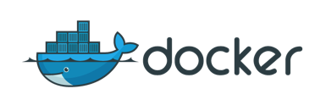
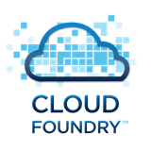
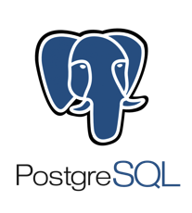
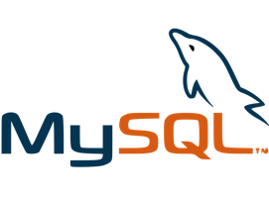

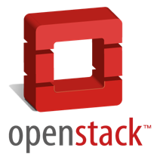
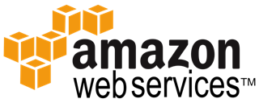





Technology Shift in Industry
CURRENT
FUTURE
3 tier web apps
devops
DRIVERS
NEEDS
Agility
Cost
Insight
Visibility
Confidence
Control
applications
infrastructure
storage

Slide 4

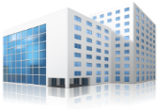














IT Service Continuity Becomes Challenging as Organizations Adopt New Trends
Near Site Data Center
DR Site
Data Center 1
Private Cloud
Public Cloud
Visibility?
Risk Awareness?
Security?
Scale?
Service Recovery?
Flexibility?
Economics?
Notes:
Trends
Growth of RaaS - CAGR is forecast at 55.2%¹
Private cloud adoption as recovery target - 84% of enterprises expect OpenStack to be part of their future plans²
Enterprises need to manage resilience across hybrid environments
Opportunity for Risk Assessment - growing at 13% CAGR³
Differentiation
Support for variety of recovery use cases and technologies (app, system, file, email)
Heterogeneous RaaS (public/private/hybrid cloud, OS, Virtual)
Partnership with HP Enterprise – established provider of Business Continuity Services - for joint RaaS offering
Application-aware recovery with SLA compliance reporting
Proactive risk assessment scanning of all environments
You choose what is right for your business – white box or full service

Slide 5
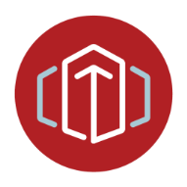









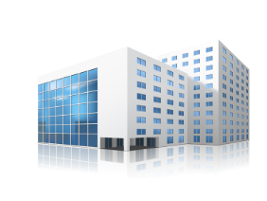

Veritas Resiliency Platform Transforms IT Service Continuity
Private Cloud
Public Cloud
PREDICTABILITY
AUTOMATION
SIMPLICITY
SCALE
Primary Data Center
Campus or DR Site
Improves Automation
Reduces Cost & Time
Enables Hybrid Cloud Architectures
Notes:
Trends
Growth of RaaS - CAGR is forecast at 55.2%¹
Private cloud adoption as recovery target - 84% of enterprises expect OpenStack to be part of their future plans²
Enterprises need to manage resilience across hybrid environments
Opportunity for Risk Assessment - growing at 13% CAGR³
Differentiation
Support for variety of recovery use cases and technologies (app, system, file, email)
Heterogeneous RaaS (public/private/hybrid cloud, OS, Virtual)
Partnership with HP Enterprise – established provider of Business Continuity Services - for joint RaaS offering
Application-aware recovery with SLA compliance reporting
Proactive risk assessment scanning of all environments
You choose what is right for your business – white box or full service

Slide 6








Introducing Veritas Resiliency Platform
Primary Data Center
Secondary Data Center
APP
Secure Replication
APP
VM
APP
APP
VM
VM
VM
Replication
Predictable Recovery across Physical & Virtual
Simplified non-disruptive DR Testing and Reporting
Co-ordinated Recovery across Data Movers
Array- and Hypervisor-based
Flexible Recovery Orchestration
VM, Application, Multi-tier Business App, Site

Slide 7
VRP Terminology introduction
RM
Resiliency Manager
Deployed as a software appliance (VSA), one per site
Provides Resiliency Platform Console with consistent experience across sites
IMS
Infrastructure Management Server
Discovers Virtual and Physical Servers, Storage and Replication infrastructure, and Applications
Deployed as a software appliance (VSA), one or more per site (scale)
Can co-locate with RM for PoC/Test only
RG
Resiliency Group
Basic unit of automation and recovery
Composed of 1 or more Virtual Machines OR Applications
Operations include: start, stop, migrate, takeover, and rehearse
VBS
Virtual Business Services
Composed of multiple Resiliency Groups
Operations include: start, stop, migrate, and takeover
RD
Resiliency Domain
The management domain of a VRP deployment

Slide 8
VRP Architecture
Mountain View
Pune
Resiliency management Layer
Resiliency Domain
(Namespace: ABC Corp.)
Resiliency Manager
(RM)
Resiliency Manager
(RM)
Infrastructure Management Layer
Infra. Domain (IMS)
(Location: MV)
Infra. Domain
(IMS)
(Location: PU)
Asset Layer
Host
Database
Virtualization
Enclosure
Host
Database
Virtualization
Enclosure
Notes:
VRP has the following core features:
■ Discovery and monitoring of data center assets like physical hosts, virtual machines and applications
■ Ability to group or tier your assets based on your production environment and business needs
■ Ability to orchestrate management of workloads in the data center
You can use VRP for day-to-day data center maintenance activities. For instance, using workload management and scheduling, you can start and stop virtual machines for maintenance.
You can also use VRP to implement a disaster recovery (DR) solution using data centers on premises in different geographical locations. The management console provides a simplified configuration experience to enable DR. Once DR is enabled, VRP provides single click recovery and rehearse operations across the data centers.

Slide 9
VRP：Resiliency manager（RM）
Resiliency Manager
VRP User Interface Framework & Server
Platform UI Pluggability Interfaces
Solution Specific UIlets
Solution Specific Services
Message Bus
Recovery Orchestration Framework
Future Service
Future Service
Recovery
Automation
Recovery as-a
Service
Solution DB
…
Application and Data Recovery Workflows
Workload Aware Events and Notifications
Reports
Core Platform Pluggability Interfaces
Basic Application Orchestration Workflows
Basic Notifications, Reports…
Data Facade
Command Facade
Authorization Service
Asset Relationship Service
Workflow Service
Logging, Scheduling, Reporting, Tasking … service
Service Lifecycle Manager
Authentication Service
Asset
Repository
Log, Alert, Event Repository
Tasks,
Workflows …
Deployment Service
Downstream Communications
Notes:
The Resiliency Manager component of Veritas Resiliency Platform (VRP) includes a set of loosely coupled services, a data repository, and a management web console. The Resiliency Manager provides the services required for protecting assets, such as virtual machines, within a resiliency domain. It also provides workload automation services.
To implement VRP, you start by deploying a Resiliency Manager and creating the resiliency domain.
One Resiliency Manager is deployed in the production data center. You deploy another Resiliency Manager in a recovery data center in another geographical location. You add the second Resiliency Manager to the same resiliency domain (join the resiliency domain).
The Resiliency Manager discovers and manages information about data center assets from an Infrastructure Management Server (IMS), another VRP component that you must add to the resiliency domain. The Resiliency Manager stores the asset information in its data repository and displays the information in its management console.
Multiple Resiliency Managers that are part of the same domain synchronize their databases using built-in replication. Each Resiliency Manager has its own web console but because the data is synchronized, all consoles show the same data. Operations can be performed from any console and the results show in all the consoles in the resiliency domain.

Slide 10
VRP：Infrastructure Management Server（IMS）
RM communications
IMS is essentially VOM infrastructure with a few VRP-specific extensions
Infrastructure Management Server
IMS discovers and monitors assets within a data center
API
Translator
Use the VRP web console to add assets to the IMS
Control
Asset DB
IMS transmits information about the assets to the Resiliency Manager
Discovery
Operations on assets are initiated from the console and carried out by IMS
Host/Hypervisor/ Array/Replication
Notes:
Each Veritas Resiliency Platform (VRP) resiliency domain must include Infrastructure Management Servers (IMSs). An IMS discovers and monitors assets within a data center. You use the VRP web console to add the assets to the IMS so that they can be discovered and monitored.
Assets include objects such as hosts, virtualization servers, and enclosures (storage arrays).
The IMS transmits information about the assets to the Resiliency Manager so that the Resiliency Manager can manage the assets. Management operations on assets (for example, starting or stopping virtual machines) that you initiate from the web console are carried out by the IMS.
If there are multiple data centers in different geographical locations, you configure a separate IMS for each geographical data center location.
Each IMS connects to only one Resiliency Manager at a time. If a Resiliency Manager failure occurs, an IMS can automatically connect to another Resiliency Manager within the same domain.
You can also configure multiple Infrastructure Management Servers in the same data center. For example, you can add a separate IMS for a separate business unit such as Human Resources or Finance. More than one IMS can be managed by the same Resiliency Manager.

Slide 11
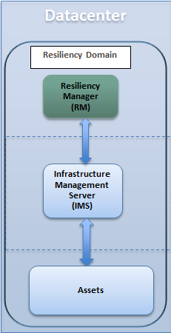
VRP：Resiliency domain
Defines the logical scope of a VRP deployment
Can extend across multiple data centers and geos
Protects assets and operate workload/DR tasks for the assets
Needs a Resiliency Manager to deploy the domain
Notes:
The resiliency domain is the logical scope of an Veritas Resiliency Platform (VRP) deployment. Within the resiliency domain, VRP can protect assets, for example, virtual machines, and orchestrate automation of workload tasks for the assets.
A resiliency domain can extend across multiple data centers and geographical locations.
To create a resiliency domain, you must first deploy a Resiliency Manager.

Slide 12
VRP Just-in-time Recovery for Virtualization
Virtual machine protection
One-click Ordered Migration/Takeover/Failback
VM
Single click, easy to use, DR orchestration for virtual machines
VM
VM
VM
VM
VM
VM
VM
VM
VM
VM
VM
VM
VM
VM
VM
VM
VM
VM
VM
VM
VM
VM
VM
VM
VM
VM
VM
VM
VM
VM
VM
VM
VM
VM
VM
VM
VM
VM
VM
VM
VM
VM
VM
VM
VM
VM
VM
Supports Array-based replication & Hypervisor Replica
PRIMARY SITE
SECONDARY SITE
Automatic DR site configuration for protected VM’s
Support for site takeover, failback and migrate
Automatic Network reconfigurations after site failover
Supports consistency groups
All storage configurations are supported
Compatible with VMware HA and MS FoC
Real time monitoring and reporting of VM and replication health

Slide 13
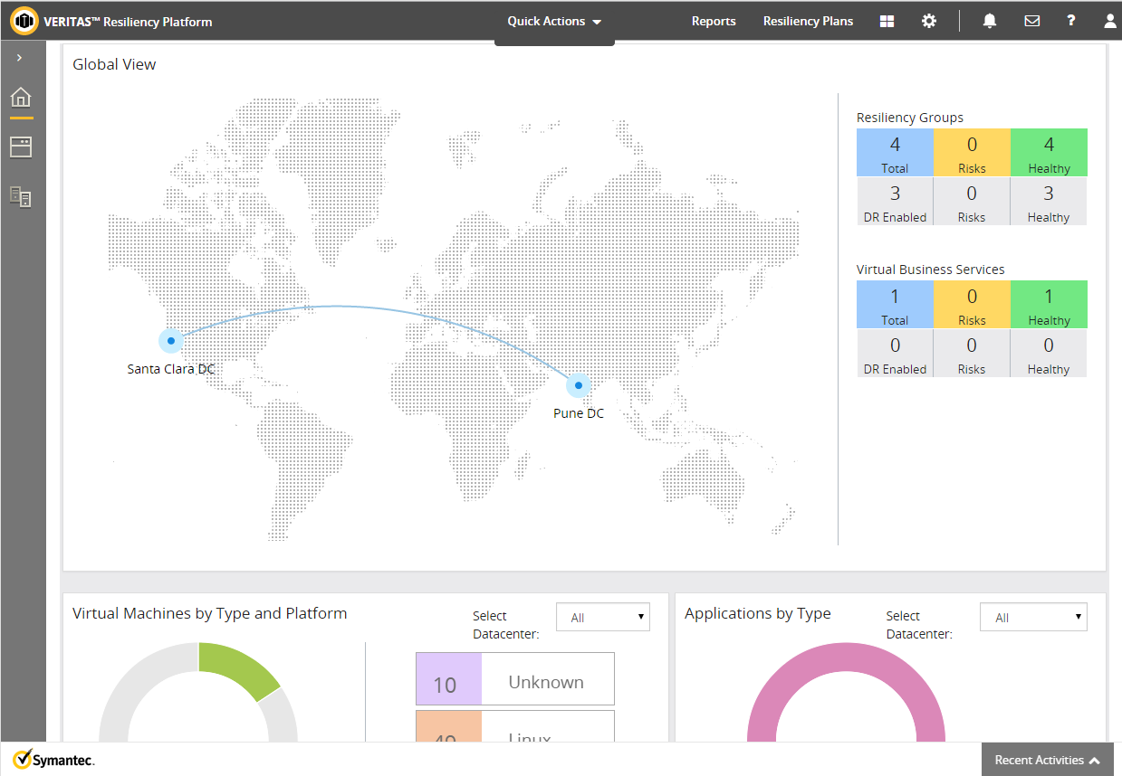
VRP Global Dashboard
Manage and control recovery operations from a single place
Detailed visibility of assets across sites
Resilient architecture for consistent view across entire enterprise
Summarized view of the DR health of the entire organization

Slide 14


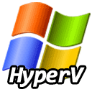


Reference：Veritas VRP with HP Helion
Customer Compartment Management
Provided by HP Helion Continuity
Service Offering Catalogue
Client account/compartment/vpc access
Onboarding source
Usage & metering source
Service Provider
Customer VPC
HP Helion OpenStack
HP Helion Continuity Recovery Center
Customer Data Center
Customer
Resiliency Domain
Resiliency Group
Multiple Protected Workloads
Infrastructure
Manager
Resiliency Manager
Infrastructure
Manager
Data mover I/O taps
Replicated Storage
(Cinder)
Unallocated virtual KVM compute pool
Replication Gateway
Replication Gateway
VPN
(over public, MPLS or leased line)
14
Notes:
Resiliency Manager (aka Controller)
Management Console for DR Operations
Cloud Aware Orchestration
Infrastructure Manager (IMS)
On-premises: Manage assets with the on-premises
On-Cloud: Manage assets hosted in the public cloud env
Openstack cloud and SR awareness
Leveraging VOM framework for discovery and operations

